Slide 1

NSUT WEST CAMPUS
HUMAN COMPUTER INTERACTION
Enhancement of UI of Website
Using Figma Tool

Slide 2
INTRODUCTION
We are trying to make the NSUT WEST CAMPUS website to be a proper design that will emerge to be more interactive and usable to its users.
Here we are focusing on pages like Home Page, Departments Page, Faculty Page, T&P Page, Location Page, and Footer.
The main focus of our enhancement is to improve the usability of our website.
By adding features like the color combination of light and dark elements for better visibility and less regression requirement by users.
Removing complex buttons and grouping same functionality menus to provide simplicity to users.

Slide 3
TOOLS USED: FIGMA
Figma is a UI/UX designing tool that is used to give look and feel to the Website and Web Apps
It helps in making a blueprint of the website without any prerequisite of development experience.
It can run on multiple platforms like macOS, Windows, etc and this tool can be used as a starter to getting into the world of website design.
By using this tool users can get an idea about the interactions of the goal website user is trying to design.

Slide 4
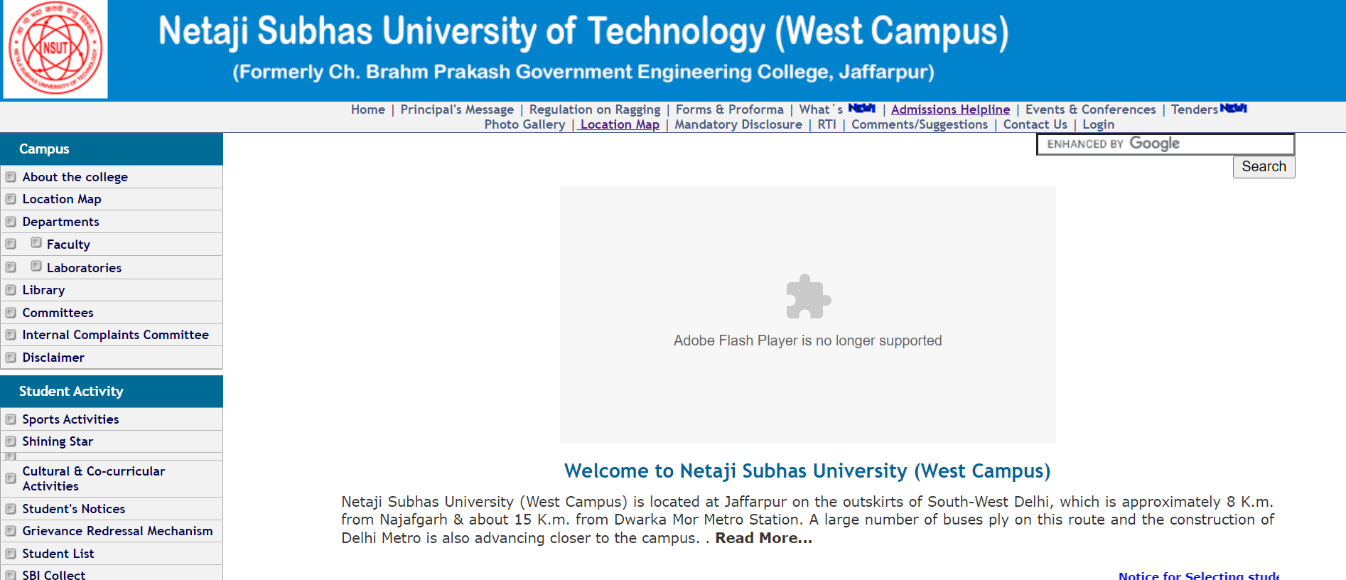
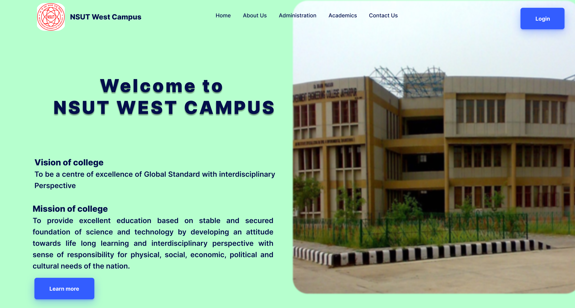
HOMEPAGE

Slide 5
Enhancements in Home Page
The light-colored background enhanced the readability of the website content.
Image of campus which was not rendered due to adobe flash player issues.
Removed the unwanted buttons to make the website homepage less complex.

Slide 6
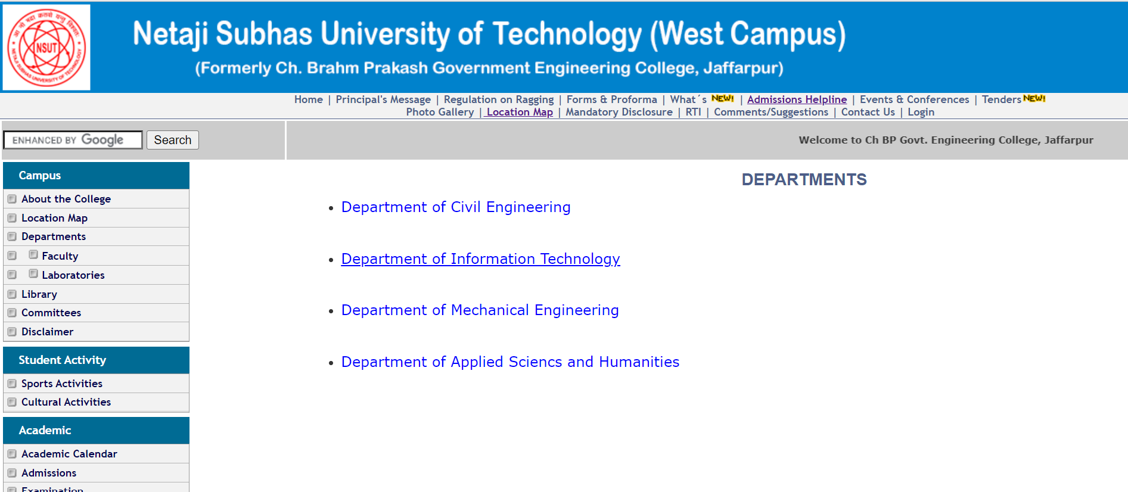
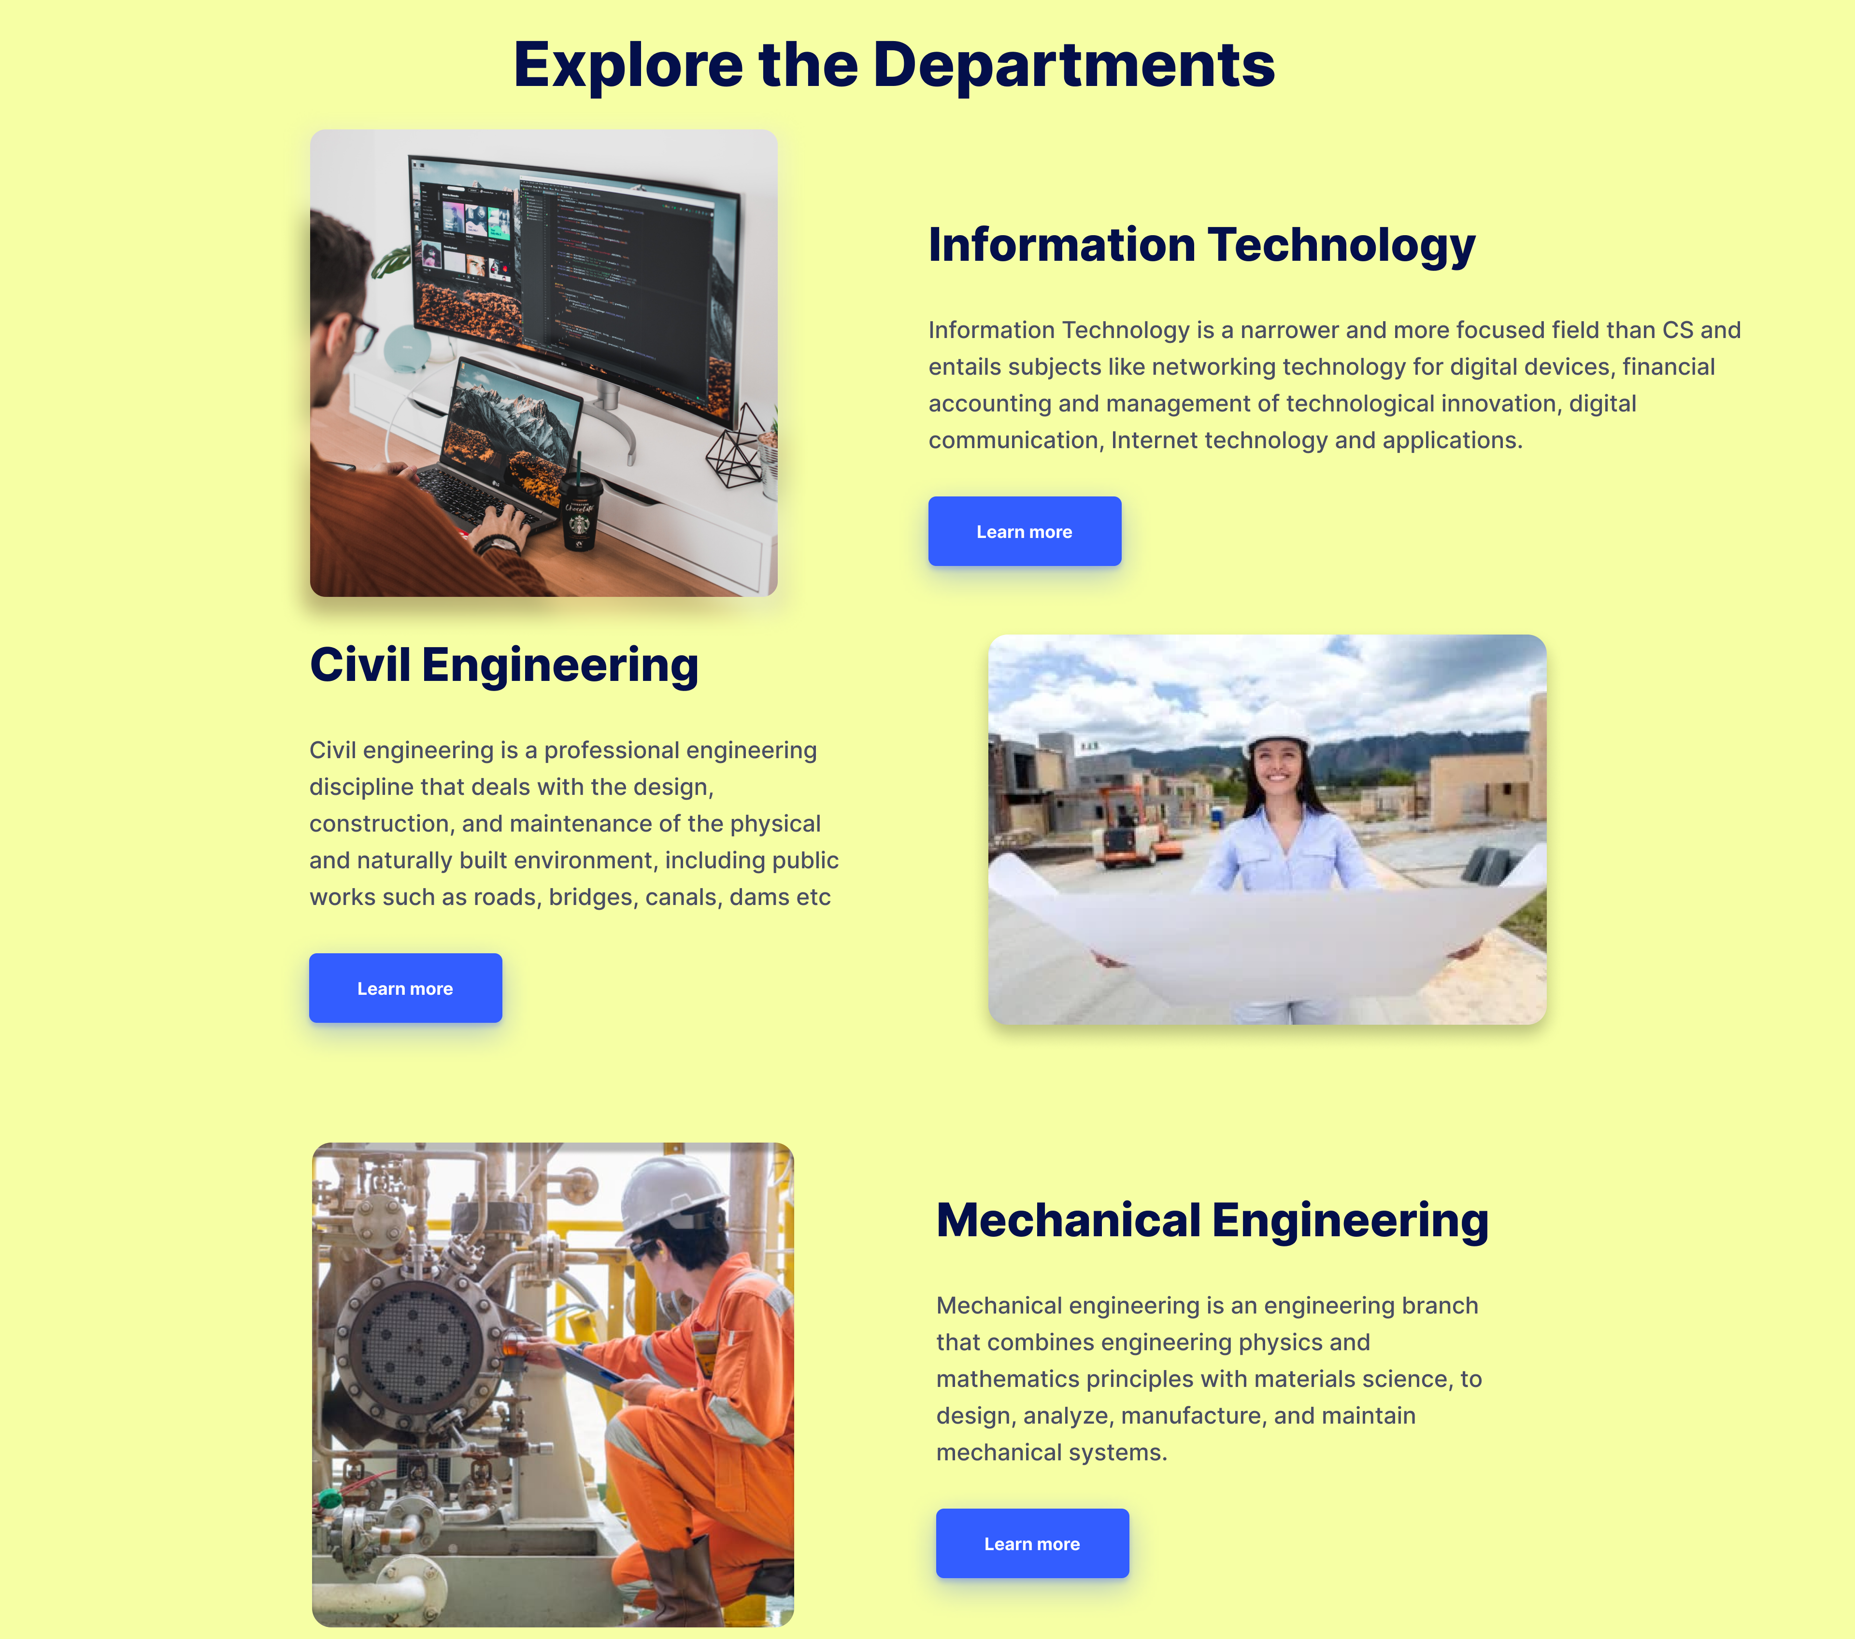
DEPARTMENTS

Slide 7
Enhancements in Departments Page
Added Photos and Summary for every Department along with the links for every Department.
By seeing the picture related to the department user will be able to interpret what is that particular department all about.
Added Learn More Buttons for detailed information about every department

Slide 8
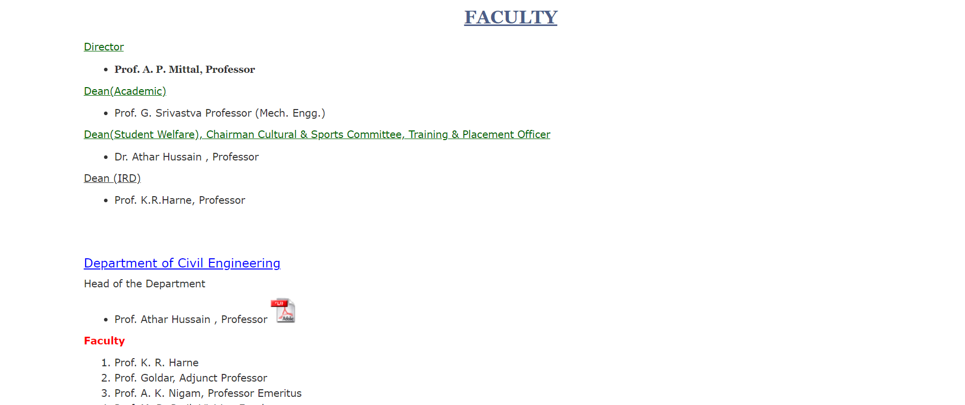
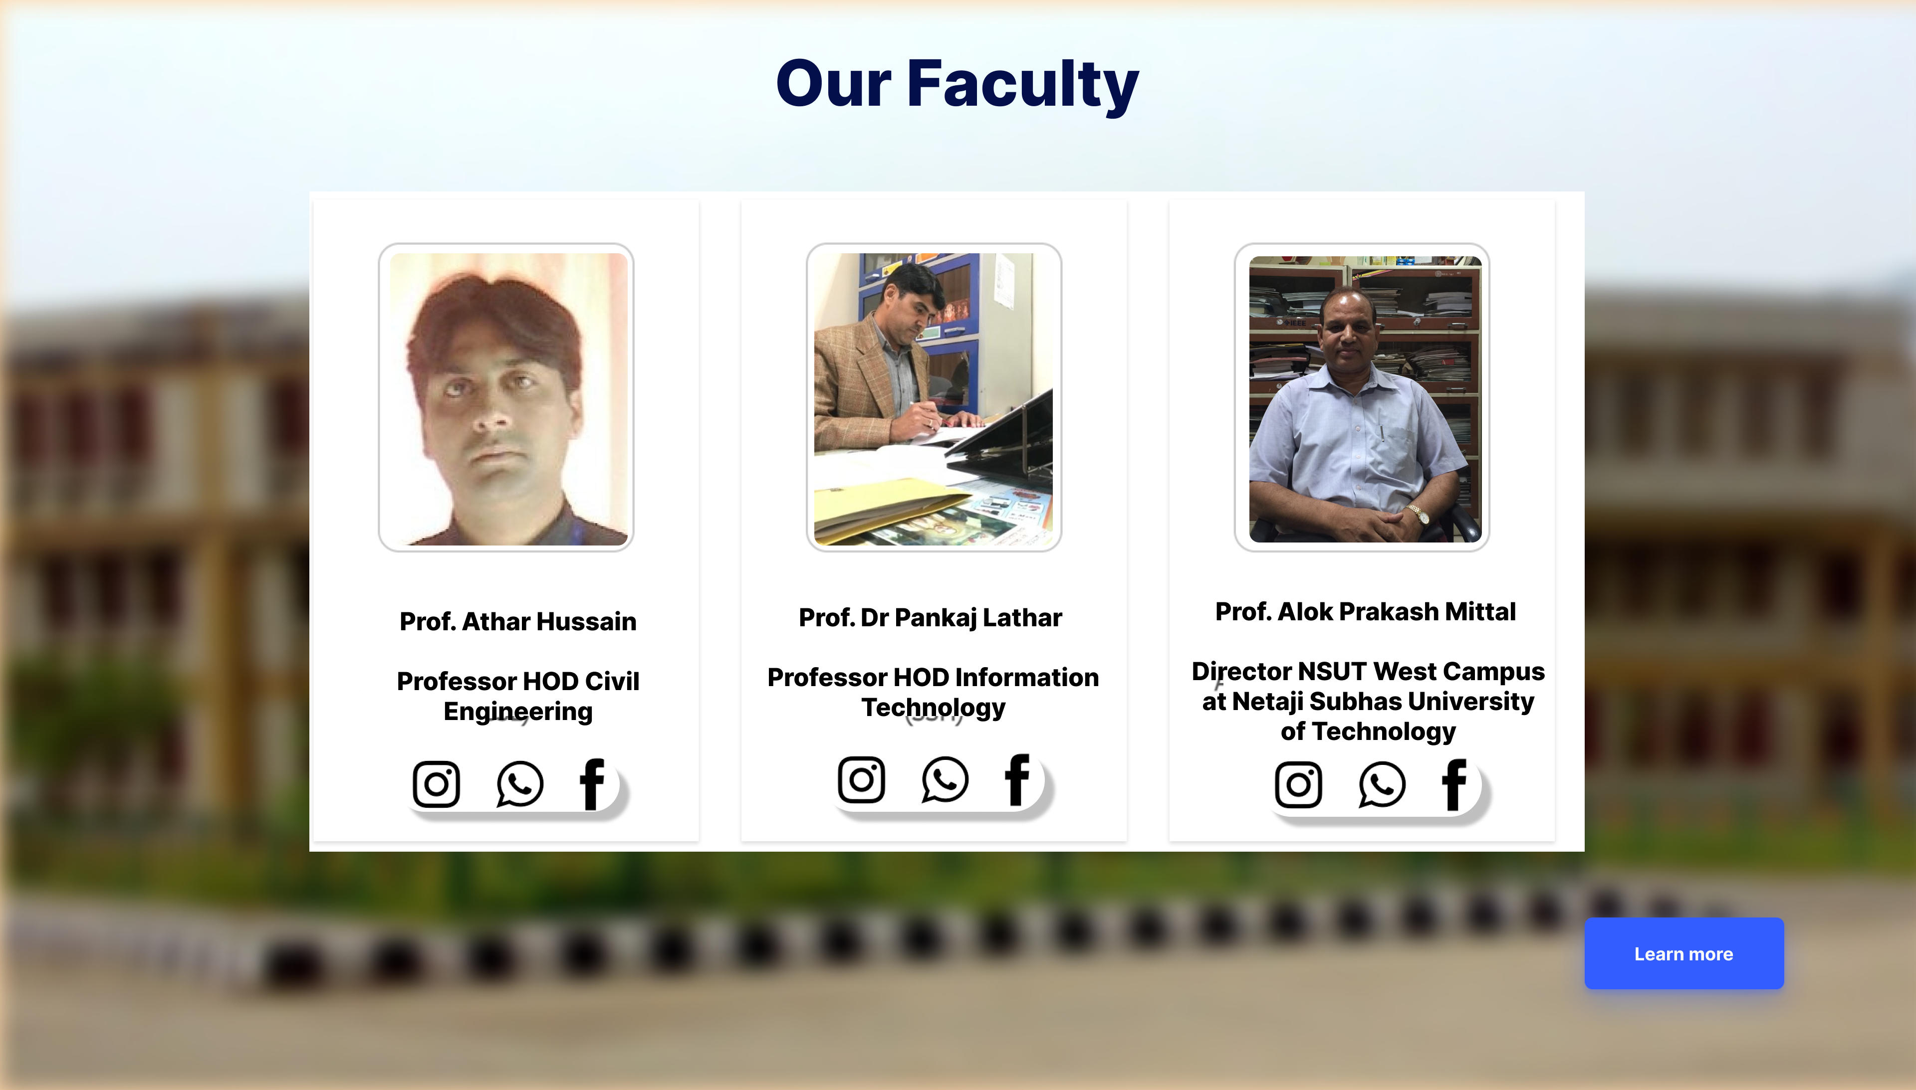
FACULTY PAGE

Slide 9
Enhancements in Faculty Page
Image of the concerned Faculty for understanding your faculty in a better way.
Social Media Handles of Professors for contacting them.
Added Learn More Buttons for detailed information about every Faculty.

Slide 10
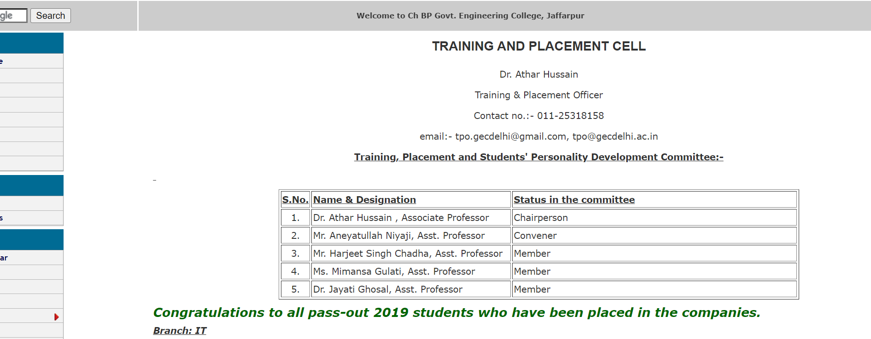
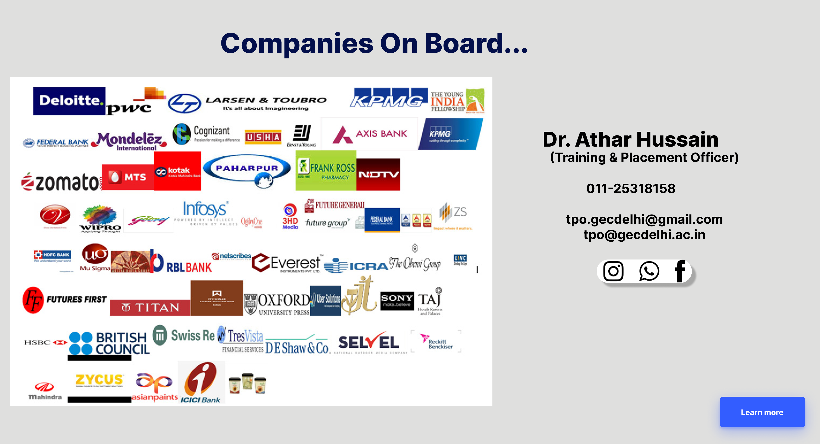
T&P PAGE

Slide 11
Enhancements in T&P Page
Logos of companies visiting the campus instead of their names for enhanced Graphics Design.
Details of the Training and Placement Officer as he is the main point of contact for every placement-related query.
Learn More button for more details about Companies and Placement Cell.

Slide 12
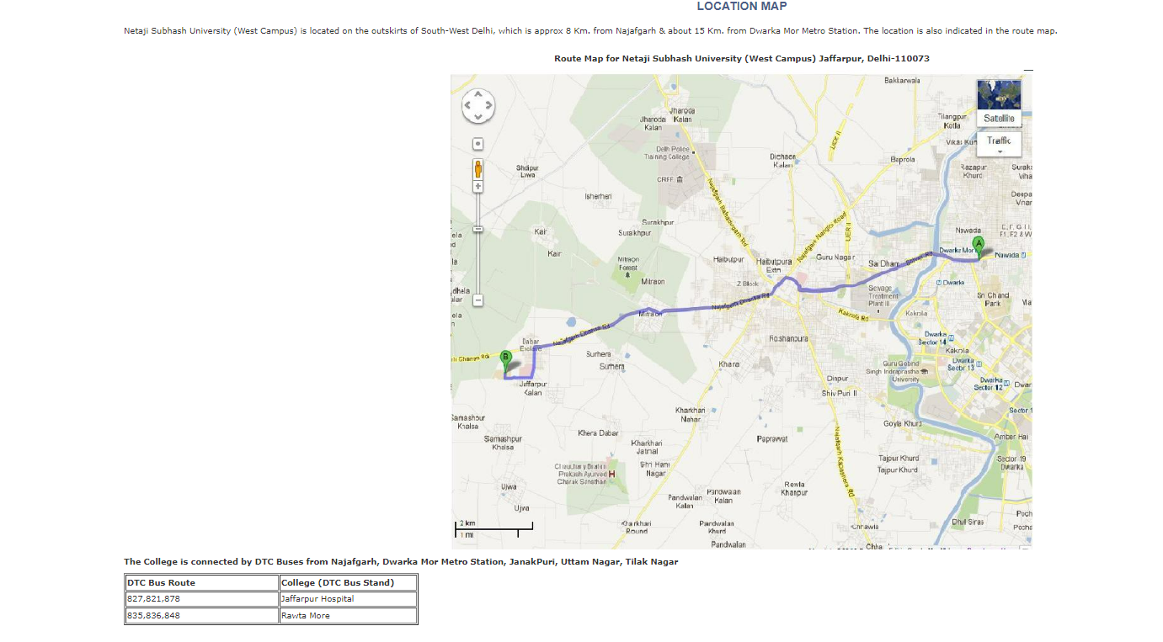
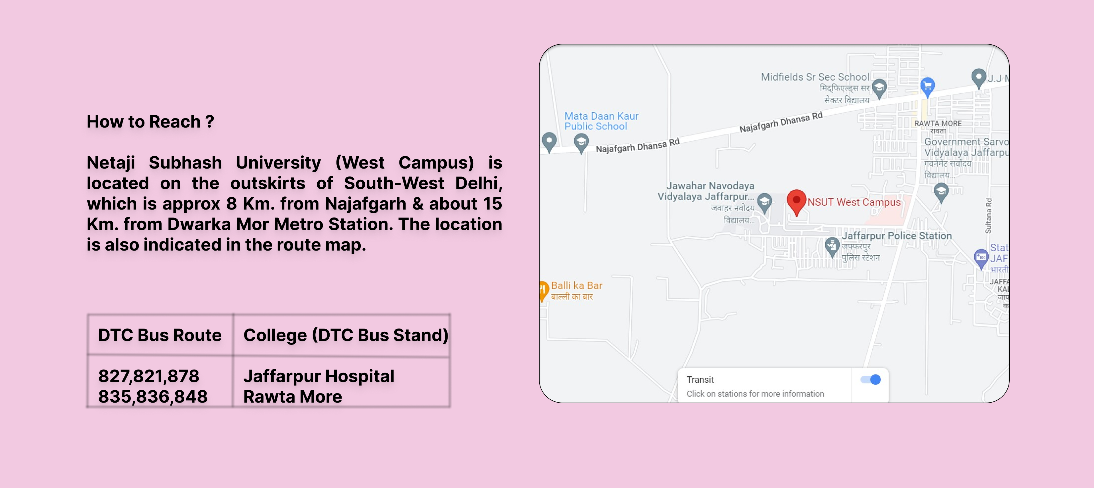
HOW TO REACH PAGE?

Slide 13
Enhancements in How to Reach Page?
We can render google Maps for dynamic location fetching i.e., we can check the distance from our current location to the college.
By using dynamic google maps, the student will be able to check the means of transport to reach the college as desired.
In case someone doesn’t have access to google maps, he/she can look at the Location and Public transport details provided statically.

Slide 14
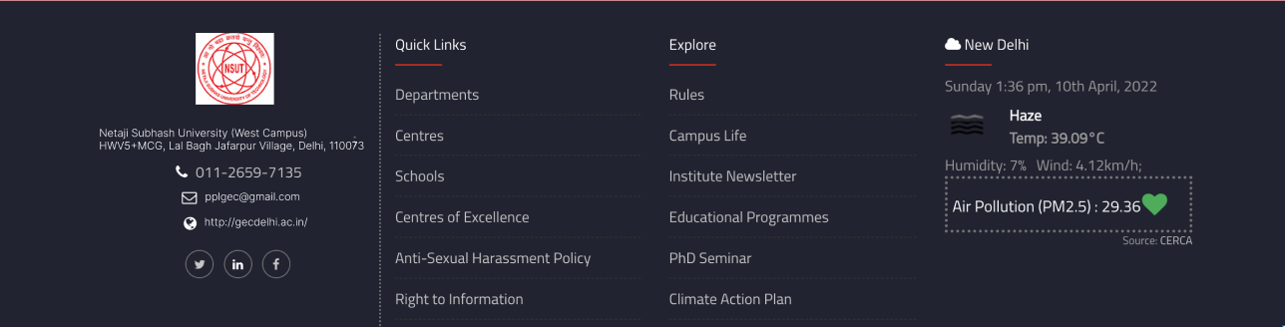
FUTURE SCOPE: ADDITIONAL FOOTER PAGE
Why Footer Page?
To decrease the complexity which was originally there in the header of the homepage we have added a footer section.
Some sections which were there in the homepage header are added here so that user when reaching the end of the webpage thinks that they have left something that can go directly from the footer to that page, which saves the scrolling time.

Slide 15
CONCLUSION
I completely changed the look and feel of the website by using the FIGMA designing tool while following various designing principles of HCI like usability, light color palette selection for better readability, WIMP model to make it more interactive, removed complex menus and grouped the same functionality in single menus to provide simplicity.

Slide 16
REFERENCES
N. Bevan, ―Usability is quality of use,‖ in Proceedings of the 6th International Conference on Human-Computer Interaction, Yokohama, Japan, July 1995.
A.Dix, J. Finlay, G. D. Abowd, and R. Beale, Human-Computer Interaction, 1993.

Slide 17


